Slide 1

Engineering Onboarding
VA.gov | [new team]
Bill Tran, VSP Frontend Engineer
bill@oddball.io
Trevor Pierce, VSP Accessibility Expert
trevor@adhocteam.us
July 18, 2019

Slide 2
Welcome!
Notes:
Trevor - Welcome to the Engineering on boarding.

Slide 3
Presentation Slides
ENGINEERING ONBOARDING
We will be sharing the PDF version of the slides at the end
Notes:
Bill

Slide 4
Agenda
ENGINEERING ONBOARDING
Introductions
Getting setup
VSP engineering best practices
Resources
Feedback
Questions
Notes:
Trevor
Introduce the team
High level setup
Best practices at a high level. Expectations.
Resource links for you to review offline
Question and answer session at the end

Slide 5
Introductions
Notes:
Trevor

Slide 6
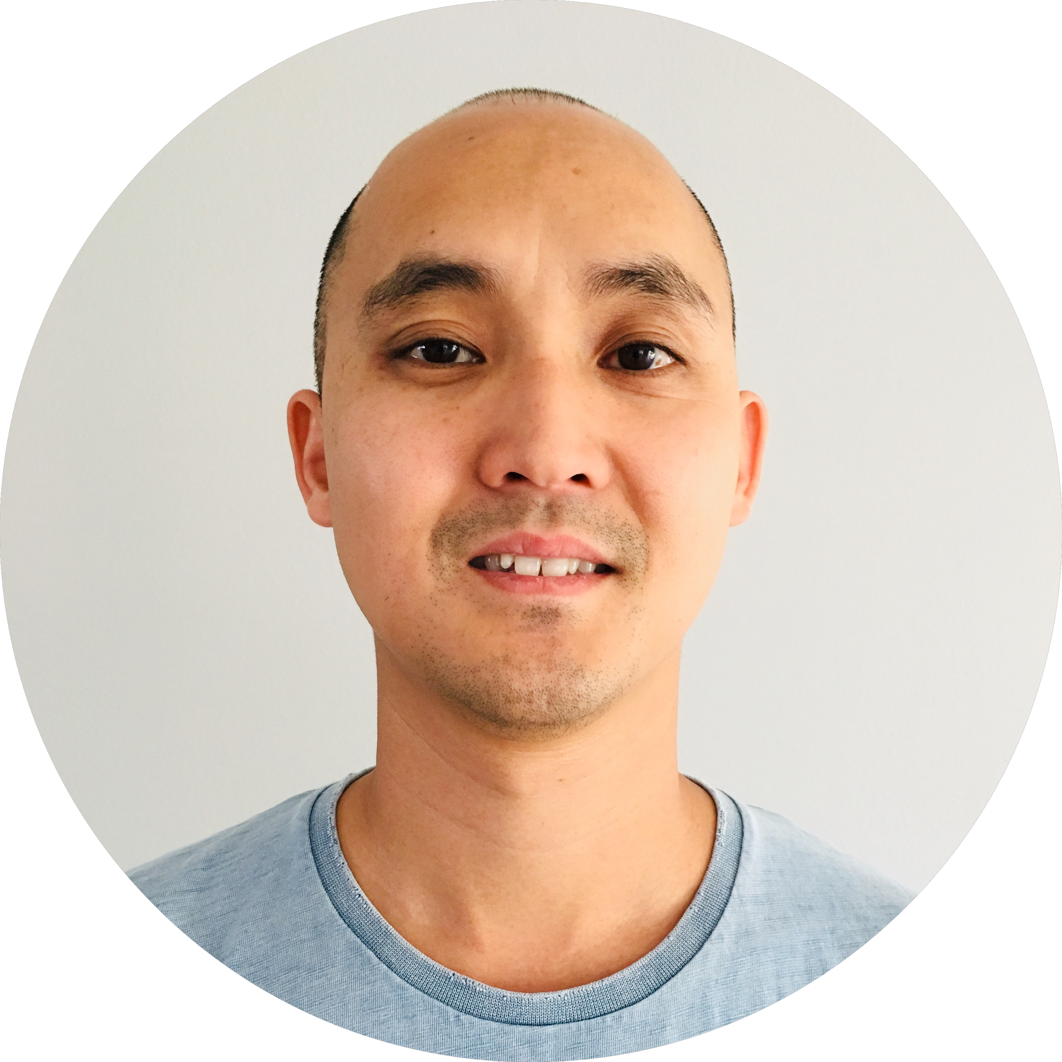


Who we are
ENGINEERING ONBOARDING
Bill Tran
Frontend Engineer
VSP Product Support
Slack: @Bill John Tran
Trevor Pierce
Accessibility Expert
VSP Product Support
Slack: @Trevor Pierce
Notes:
Trevor

Slide 7
Introductions
ENGINEERING ONBOARDING
One minute each:
Name
Role
If you couldn’t be a developer anymore what would you be?

Slide 8
VSP Development Support Team
ENGINEERING ONBOARDING
VSP & VFS
Veteran Services Platform (VSP)
Veteran Facing Services (VFS)
Names and roles
Andrea Hewitt - Project Manager
Layla Soileau - Designer
Emily Waggoner - Designer
Bill Tran - Front-end Engineer
Trevor Pierce - Accessibility Expert / Front End Engineer
Peter Hill - Test Engineer
TBD - Back-end Engineer
DSVA Slack
#vfs-platform-support channel
Notes:
Bill

Slide 9
Getting Setup

Slide 10
Access, Credentials & Local Envs
ENGINEERING ONBOARDING
VA Digital Service - Developer Documentation
Onboarding for External Contractors

Slide 11
VSP Engineering Patterns

Slide 12
VSP responsibility
ENGINEERING ONBOARDING
Developers experience
Code quality
Code consistency
Prevent VA.gov breakage

Slide 13
Documentation
ENGINEERING ONBOARDING
Engineering Best Practices

Slide 14
Motivation
ENGINEERING ONBOARDING
Provide direction, resources and support
Set expectations for a successful partnership and launch

Slide 15
Tickets/Issues/User Stories

Slide 16
Tickets/Issues/User stories
ENGINEERING ONBOARDING
Refine tickets until they are atomic
Guideline: no larger than a week's worth of effort

Slide 17
Tickets/Issues/User stories
ENGINEERING ONBOARDING
Use epics to tether together common bodies of atomic work

Slide 18
Tickets/Issues/User stories
ENGINEERING ONBOARDING
Use the GitHub issue template
Include background that provides context, resources, links, images, and/or POCs
Identify clear, concise, achievable acceptance criteria
When applicable, identify risks that could impact delivery, resources, quality, etc.

Slide 19
Tickets/Issues/User stories
ENGINEERING ONBOARDING
Use tickets as a forum to discuss and capture implementation ideas, questions, patterns, access, etc.
In particular when implementation path is not clear, favor discussion prior to submitting a PR
Example
https://github.com/department-of-veterans-affairs/vets.gov-team/issues/8738

Slide 20
Tickets/Issues/User stories
ENGINEERING ONBOARDING
Maintain accurate ticket status details (i.e. pipelines, assignees, blockers, etc.)

Slide 21
Tickets/Issues/User stories
ENGINEERING ONBOARDING
Subscribe relevant VSP team members for visibility and agile support
Slack/GitHub Groups
frontend-review-group
backend-review-group

Slide 22
Pull Requests

Slide 23
Pull Requests
ENGINEERING ONBOARDING
Post/update code in a PR frequently
Multiple times per week, no less than once a week
Be it work-in-progress, or a PR ready for review

Slide 24
Pull Requests
ENGINEERING ONBOARDING
Favor multiple, smaller, focused PR's over large PR's
The master branches of vets-website and vets-api are deployed every weekday

Slide 25
Pull Requests
ENGINEERING ONBOARDING
Use the GitHub pull request template
We prefer more details then assumptions
When applicable, include screenshots
New API endpoint docs, new UI, etc.
Examples
https://github.com/department-of-veterans-affairs/vets-api/pull/3002
https://github.com/department-of-veterans-affairs/vets.gov-team/issues/19143

Slide 26
Pull Requests
ENGINEERING ONBOARDING
Identify work-in-progress PR's by adding WIP to the title, or using GitHub's draft pull request feature

Slide 27
Pull Requests
ENGINEERING ONBOARDING
Feel free to request reviews for a work-in-progress PR, and then use GitHub's re-request review feature to get final PR approvals

Slide 28
Process

Slide 29
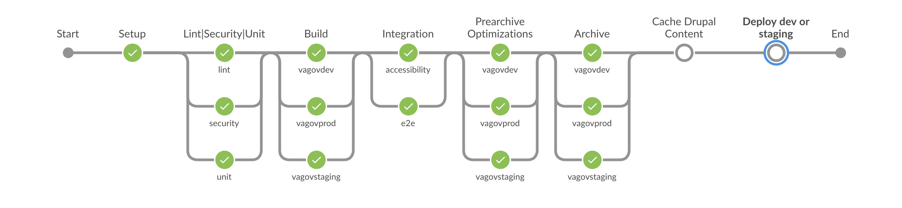
Process
ENGINEERING ONBOARDING
Deployment process

Slide 30
Process
ENGINEERING ONBOARDING
Ensure comprehensive test coverage is in place for all code additions/updates

Slide 31
Process
ENGINEERING ONBOARDING
Hook into/add monitoring and alerting for your service

Slide 32
Process
ENGINEERING ONBOARDING
Capture relevant analytics for the feature

Slide 33
Process
ENGINEERING ONBOARDING
Add documentation to support your code and service (Yard docs, product docs, POC's, etc.)

Slide 34
Backend Development

Slide 35
Backend Development
ENGINEERING ONBOARDING
Discuss your implementation ideas with VSP backend team members early and often
There are many common patterns and classes that are in place in Vets-API that should be leveraged, that we can point you to
Notes:
the goal is to avoid writing code that they will have to throw away or dramatically refactor
also the goal is to leverage the existing common classes and patterns in Vets-API, as they are already wired into our overall error handling, logging and monitoring, etc.

Slide 36
Backend Development
ENGINEERING ONBOARDING
RuboCop is used for Ruby style linting
Enforced at the CI level
Notes:
they can always just run `rubocop` locally to see where things stand
if they do not, it will be ran during CI
if RuboCop fails during CI, Jenkins will say that there was a RuboCop failure, and then they would run `rubocop` locally to see the exact details

Slide 37
Backend Development
ENGINEERING ONBOARDING
Screencast on patterns and practices when adding an endpoint to Vets-API (30min.)
Slide deck on adding endpoints to Vets-API, includes links to code in the screencast
Vets-API Endpoint Punch List
Notes:
this is a presentation Harry gave at an engineering meeting, edited down to just presentation itself
it goes over the typically, best practices implementation for adding a new endpoint in Vets-API
the slide deck includes links to everything that was covered in the screencast
the screencast is essentially walking you through all of the items in the “Vets-API Endpoint Punch List”

Slide 38
Frontend Development

Slide 39
Frontend Development
ENGINEERING ONBOARDING
Familiarize yourself with the Client application documentation site
It summarizes several common tasks, common components, and the high level structure of vets-website

Slide 40
Frontend Development
ENGINEERING ONBOARDING
We encourage frequent merges of small pull requests and using environment flags to keep partially complete or in progress features from appearing in production

Slide 41
Frontend Development
ENGINEERING ONBOARDING
We rely heavily on automated testing in our continuous integration flow to detect regressions
e2e
unit
linting
axe-core
Git hooks and CI for code quality
It's important to follow our unit testing and end to end testing patterns to maintain a highly collaborative environment

Slide 42
508/Accessibility

Slide 43
508/Accessibility
ENGINEERING ONBOARDING
VSP takes a multiple approach to accessibility testing
Notes:
VSP takes a multiple approach to accessibility
Page scans (semi-automated)
e2e scans (automated)
Manual testing with keyboards
Manual testing with screen readers

Slide 44
508/Accessibility
ENGINEERING ONBOARDING
Add the aXe browser plugin
Notes:
VSP prefers to do semi-automated testing while developing new features or improving existing ones
This helps identify a number of accessibility issues when they are easiest to fix

Slide 45
508/Accessibility
ENGINEERING ONBOARDING
Rendered pages must pass an aXe check in e2e suite
axeCheck helper function
Notes:
Automated accessibility tests are included in e2e test suites
These tests run every time a build task is started
Help limit regressions as code evolves

Slide 46
508/Accessibility
ENGINEERING ONBOARDING
Applications should be usable with just a keyboard
Notes:
Applications should be fully usable with a keyboard
Use native elements like buttons
Can be tested during development and as part of a formal audit

Slide 47
508/Accessibility
ENGINEERING ONBOARDING
Ensure proper keyboard focus settings for single-page apps
Notes:
Focus should be managed for client-side route changes
Focus should be managed when things are added or removed from the page
Improves experiences for keyboard and assistive device users

Slide 48
508/Accessibility
ENGINEERING ONBOARDING
Ensure headings are properly nested
Notes:
Headings give a page semantic meaning
They give us good hooks for visual styling and assist device navigation
Nesting organizes content according to its importance

Slide 49
General

Slide 50
General
ENGINEERING ONBOARDING
Reminder, VSP engineers are available to review and/or discuss changes!

Slide 51
Resources

Slide 52
Resources
ENGINEERING ONBOARDING
Slack Channels
#vfs-platform-support
#vfs-all-teams
#by-light-general
VA Digital Service - Developer Documentation
Onboarding for External Contractors
Engineering best practices
Slack/GitHub Groups
frontend-review-group
backend-review-group

Slide 53
5-minute survey
Link to survey
Notes:
Emily

Slide 54
How are you feeling?
UX ONBOARDING
Has anything changed?
What are you excited about?
What are you nervous about?
What questions do you have?
Notes:
Layla facilitates
Emily takes notes

Slide 55
Thank you!

